Slide 1
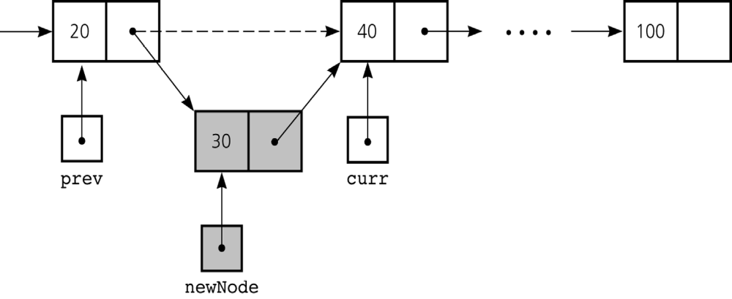
Inserting a Node into a Specified Position of a Linked List
To create a node for the new item
  newNode = new Node(item);
To insert a node between two nodes
  newNode.setNext(curr);
  prev.setNext(newNode);
Figure 5-13
Inserting a new node into a linked list
Notes:
Does it work in boundary cases?

Slide 2
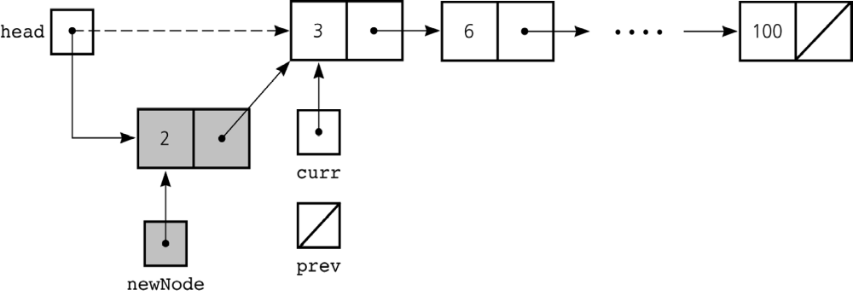
Inserting a Node into a Specified Position of a Linked List
To insert a node at the beginning of a linked list
  newNode.setNext(head);
  head = newNode;
Figure 5-14
Inserting at the beginning of a linked list

Slide 3
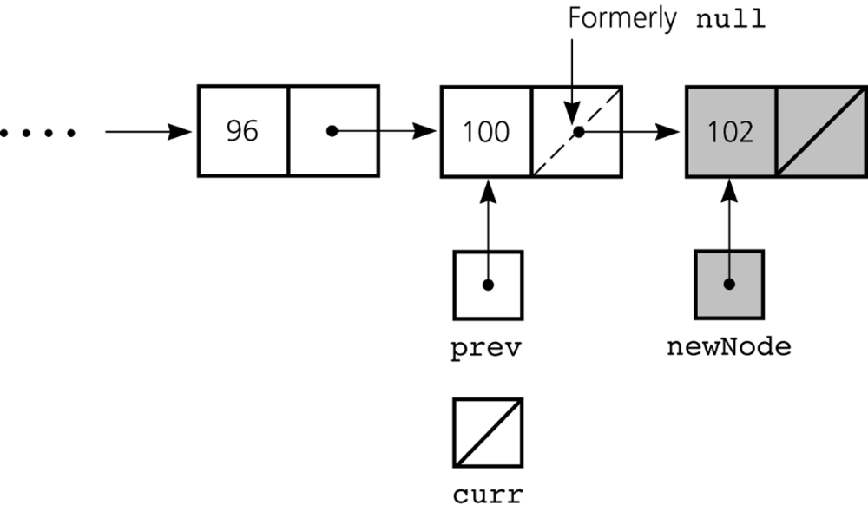
Inserting a Node into a Specified Position of a Linked List
Inserting at the end of a linked list is not a special case if curr is null
  newNode.setNext(curr);
  prev.setNext(newNode);
Figure 5-15
Inserting at the end of a linked list

Slide 4
Inserting a Node into a Specified Position of a Linked List
Three steps to insert a new node into a linked list
  Determine the point of insertion
  Create a new node and store the new data in it
  Connect the new node to the linked list by changing references

Slide 5
Determining curr and prev
Determining the point of insertion or deletion for a sorted linked list of objects
  assume we have newValue which should inserted (deleted)
  for ( prev = null, curr = head;
  (curr != null) &&
  (newValue.compareTo(curr.getItem()) > 0);
  prev = curr, curr = curr.getNext() ) {
  } // end for

Slide 6
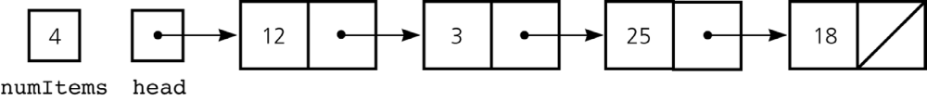
A Reference-Based Implementation of the ADT List
A reference-based implementation of the ADT list
  Does not shift items during insertions and deletions
  Does not impose a fixed maximum length on the list
Figure 5-18
A reference-based implementation of the ADT list

Slide 7
A Reference-Based Implementation of the ADT List
Default constructor
  Initializes the data fields numItems and head
List operations
  Public methods
    isEmpty
    size
    add
    remove
    get
    removeAll
  Private method
    find

Slide 8
Reference-based Implementation of ADT List
public boolean isEmpty() {
return numItems == 0;
} // end isEmpty
public int size() {
return numItems;
} // end size

Slide 9
Reference-based Implementation of ADT List
private Node find(int index) {
// --------------------------------------------------
// Locates a specified node in a linked list.
// Precondition: index is the number of the desired
// node. Assumes that 1 <= index <= numItems+1
// Postcondition: Returns a reference to the desired
// node.
// --------------------------------------------------
Node curr = head;
for (int skip = 1; skip < index; skip++) {
curr = curr.getNext();
} // end for
return curr;
} // end find

Slide 10
Reference-based Implementation of ADT List
public Object get(int index)
throws ListIndexOutOfBoundsException {
if (index >= 1 && index <= numItems) {
// get reference to node, then data in node
Node curr = find(index);
Object dataItem = curr.getItem();
return dataItem;
}
else {
throw new ListIndexOutOfBoundsException(
"List index out of bounds on get");
} // end if
} // end get

Slide 11
Reference-based Implementation of ADT List
public void add(int index, Object item)
throws ListIndexOutOfBoundsException {
if (index >= 1 && index <= numItems+1) {
if (index == 1) {
// insert the new node containing item at
// beginning of list
Node newNode = new Node(item, head);
head = newNode;
}
else {
Node prev = find(index-1);
// insert the new node containing item after
// the node that prev references
Node newNode = new Node(item, prev.getNext());
prev.setNext(newNode);
} // end if
numItems++;
}
else {
throw new ListIndexOutOfBoundsException(
"List index out of bounds on add");
} // end if
} // end add

Slide 12
Reference-based Implementation of ADT List
public void remove(int index)
throws ListIndexOutOfBoundsException {
if (index >= 1 && index <= numItems) {
if (index == 1) {
// delete the first node from the list
head = head.getNext();
}
else {
Node prev = find(index-1);
// delete the node after the node that prev
// references, save reference to node
Node curr = prev.getNext();
prev.setNext(curr.getNext());
} // end if
numItems--;
} // end if
else {
throw new ListIndexOutOfBoundsException(
"List index out of bounds on remove");
} // end if
} // end remove

Slide 13
Comparing Array-Based and Referenced-Based Implementations
Size (number of elements stored)
  Array-based
    Fixed size
        Can you predict the maximum number of items in the ADT?
        Will an array waste storage?
    Resizable array
        Increasing the size of a resizable array can waste storage and time
  Reference-based
      Do not have a fixed size
        Do not need to predict the maximum size of the list
        Will not waste storage (for data)

Slide 14
Comparing Array-Based and Referenced-Based Implementations
Storage requirements
  Array-based
    Requires less memory than a reference-based implementation
      There is no need to store explicitly information about where to find the next data item
  Reference-based
    Requires more storage
      An item explicitly references the next item in the list

Slide 15
Comparing Array-Based and Referenced-Based Implementations
Access time
  Array-based
    Constant access time
  Reference-based
    The time to access the i^{th} node depends on I
But when processing all elements: both implementations require constant time on average

Slide 16
Comparing Array-Based and Referenced-Based Implementations
Insertion and deletions
  Array-based
    Require you to shift the data
  Reference-based
    Do not require you to shift the data
    Require a list traversal
Notes:
- Ins del in LL: fast at the beginning. In A: fast at the end (but can be easily modified to make them fast at the beginning).
Conclusion:
Which implementation to use depends on context.

